Slide 1


Omniconnect
One Stop Social Media App
By -
Milind (Data Science)
Prashant (UX Design)
Krishna (Software Development)
Rishabh (Software Development)
Tafadzwa (Cyber Security)

Slide 2

Target Audience
01
02
03
Demographics
Geographical Reach
User preference
Millennials, Young adults and Professionals
Regions with high internet penetration and smartphone usage
Gradually expanding to global audience
Who value convenience, privacy and a rich multimedia experience

Slide 3
Demographics
Existing demographics of Whatsapp, Instagram and Facebook
01
02
03
Whatsapp
Instagram
Facebook
Age 26 to 35 years with 27%
Age 25 to 34 years with 32%
Age 25 to 34 years with 24.4%

Slide 4

Added Features:
Chat Bot
Payment Option to the app
Calendar to organize events

Slide 5
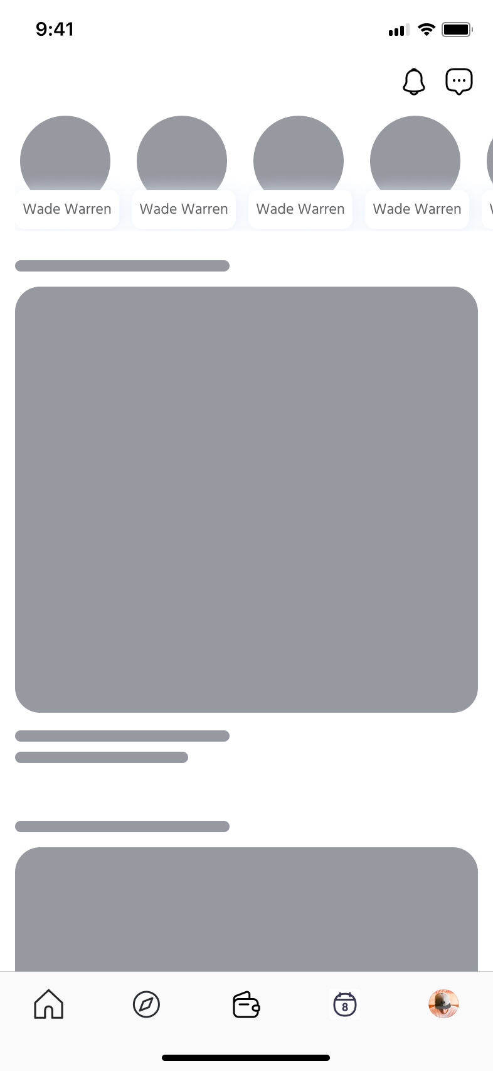
Lowfidelity

Slide 6
Security
01
02
03
How will Omni secure users data?
Additional User Authentication
How will messages/files be encrypted?
-Secure Authentication
-Encryption
-Secure data storage
-Privacy Controls
-Regular Security Auditing
Private chat biometric auth.
-Secure Payment Option
-end-to-end encyption

Slide 7
Security
04
05
06
Managing content, preventing bots, malicious acts & spread of disinformation
Security concerns how the app ensures privacy
Traction on Security
-Cyberbullying and Harassment-implement reporting mechanisms
-Third-party integrations-vet, carefully select third parties
-Data breaches- practice Secure SDLC
-Unauthorized Access to Accounts-strong password policies, MFA, mechanisms to prevent unauthorized access
-Continual updates
-User awareness programs
-Bot detection algorithms
-User Account Verification
-Regular Security Audits
-IP Blocking and Reputation Lists

Slide 8




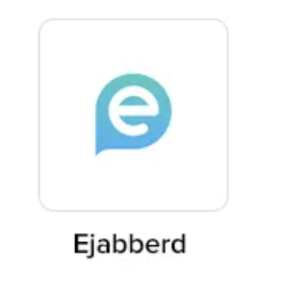
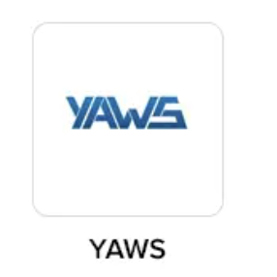
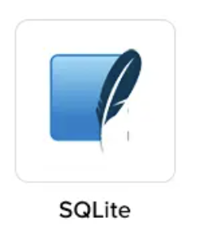
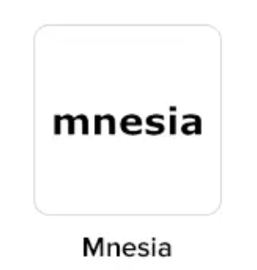

Technology Stack

Slide 9
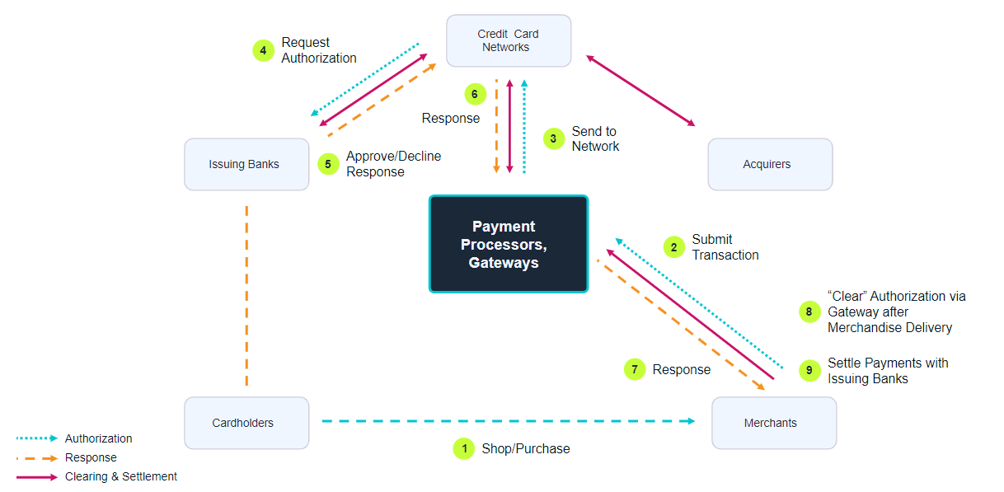
Payment workflow

Slide 10
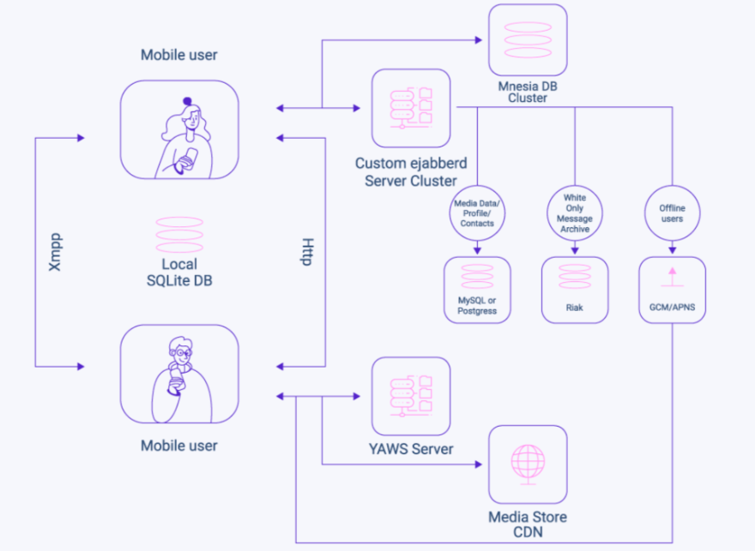
High Level System Architecture

Slide 11
Leveraging Machine Learning
01
02
03
Chat bot
Recommendation
AI based editor
A chatbot to interact with all the users on the application.
Recommendation of content to the user, according to their interests and taste.
Will use image processing, and object recognition to process the image pixels and use filters on it.

Slide 12
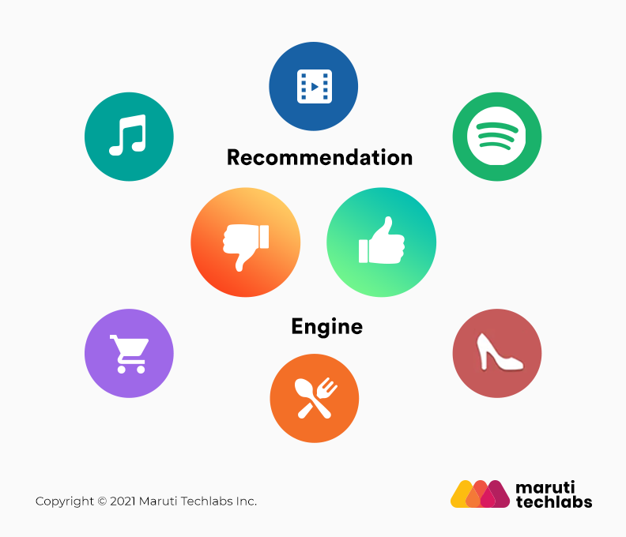
Recommendation Methods:
Content-Based Filtering:
Another approach is to use content-based filtering, which involves analyzing the characteristics of songs to make recommendations based on those characteristics.
Collaborative Filtering:
Another approach to building a recommendation engine is to use collaborative filtering, which involves analyzing user behavior to identify patterns and make recommendations based on those patterns.
Neural Networks:
Embedding Layers: These layers represent users and items as dense vectors, capturing semantic relationships.
Network Architectures: Wide & Deep, DLRM, RNNs, Transformer Blocks

Slide 13
Evaluating Models:
01
02
03
Mean Average Precision(MAP)
Mean Reciprocal Rank (MRR)
NDCG
Measures the average precision across all users.
Consider the rank of the first relevant item. It takes the reciprocal of "first relevant item rank".
Normalized Discounted Cumulative Gain: Accounts for the position of relevant items in the recommendation list.

Slide 14

Website
omniconnect.com
Phone
+1 469 682 9801
Omniconnect
Thank you

Slide 15
